Slide 1

JavaFX Basics

Slide 2
Motivations
JavaFX is a new framework for developing Java graphical user interface (GUI) programs.
The JavaFX API is an excellent example of how the OO principle is applied.
This chapter serves two purposes:
First, it presents the basics of JavaFX programming.
Second, it uses JavaFX to demonstrate OOP.
Specifically, this chapter introduces the framework of JavaFX and discusses JavaFX GUI components and their relationships.
Notes:
Application programming interface

Slide 3
JavaFX vs Swing and AWT
When Java was introduced, the GUI classes were bundled in a library known as the Abstract Windows Toolkit (AWT).
AWT is fine for developing simple graphical user interfaces, but not for developing comprehensive GUI.
In addition, AWT is prone to platform-specific bugs.
The AWT components were replaced by a more robust, versatile, and flexible library known as Swing.
Swing components depend less on the target platform and use less of the native GUI resource.
With the release of Java 8, Swing is replaced by a completely new GUI platform known as JavaFX.

Slide 4
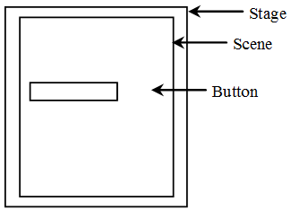
Basic Structure of JavaFX
Application
Override the start (Stage) method
Stage, Scene, and Nodes

Slide 5
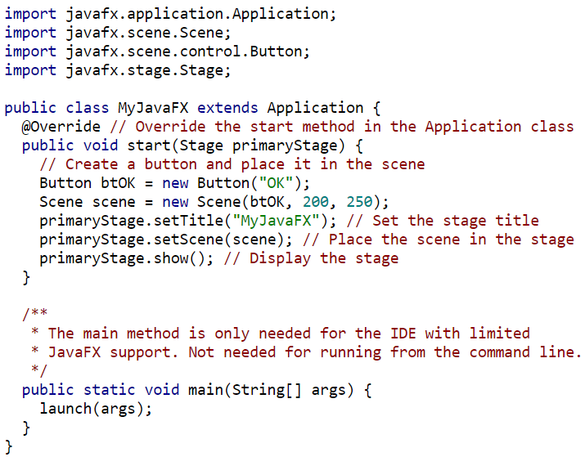
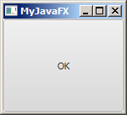
Extend Application
Override start
Create a button
Create a scene
Set a scene
Display stage
Launch application
Notes:
The launch method (line 22) is a static method defined in the Application class for launching a stand-alone JavaFX application. The start method normally places UI controls in a scene and displays the scene in a stage A Stage object is a window.
A Stage object called primary stage is automatically created by the JVM when the application is launched. JavaFX names the Stage and Scene classes using the analogy from the theater.

Slide 6

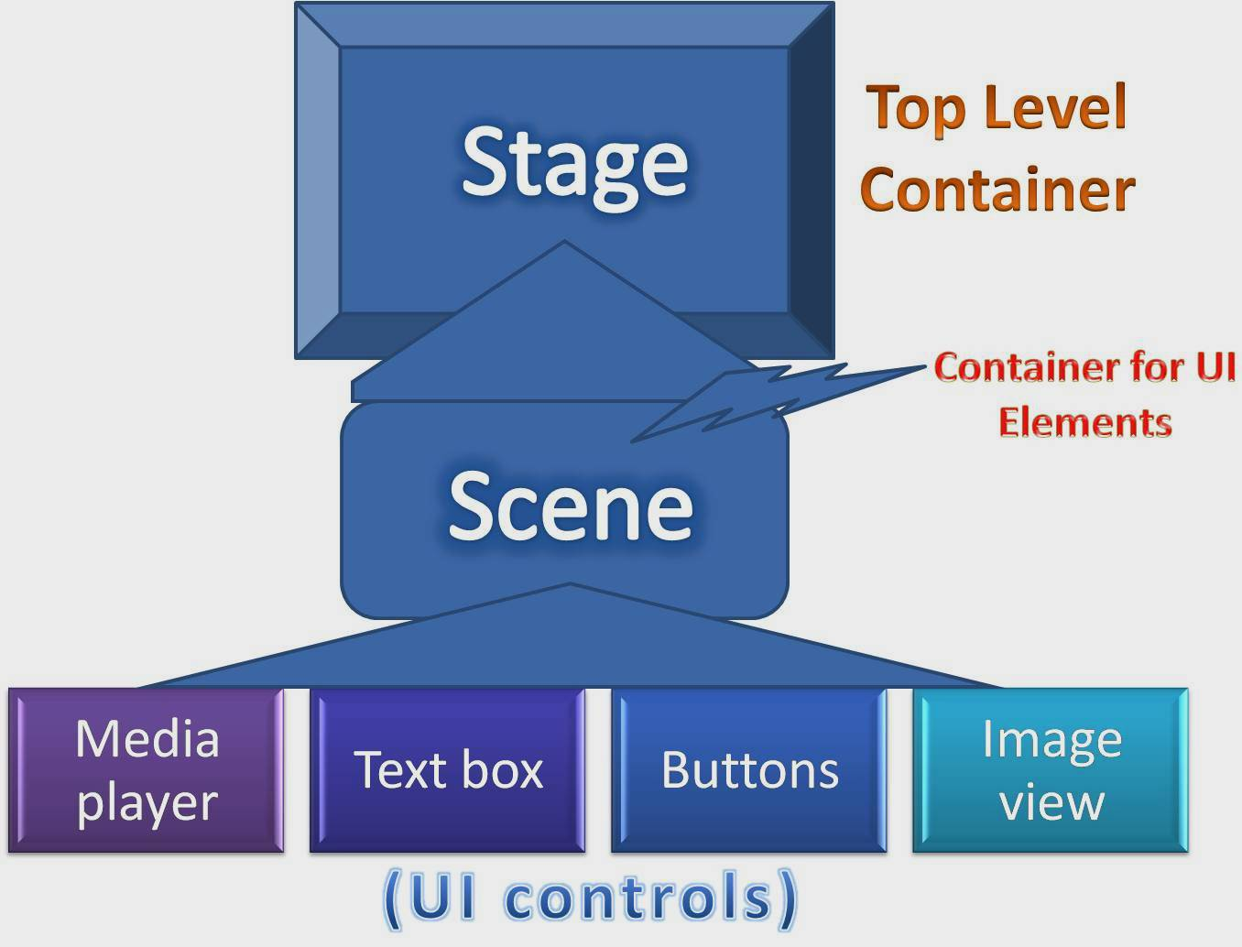

Slide 7
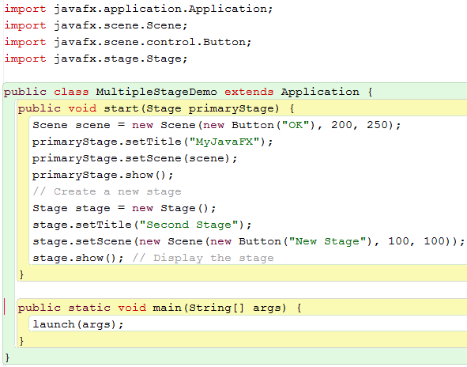

Slide 8
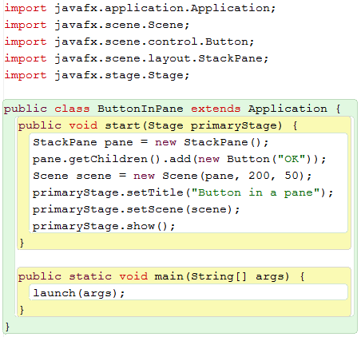
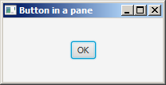
Notes:
use container classes, called panes, for automatically laying out the nodes in a desired location and size.

Slide 9
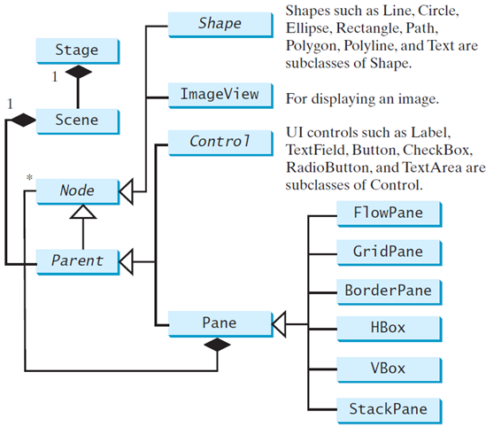
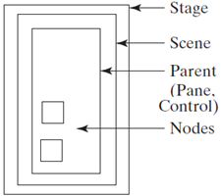
Panes, UI Controls, and Shapes

Slide 10
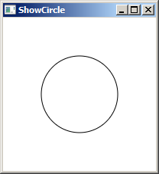
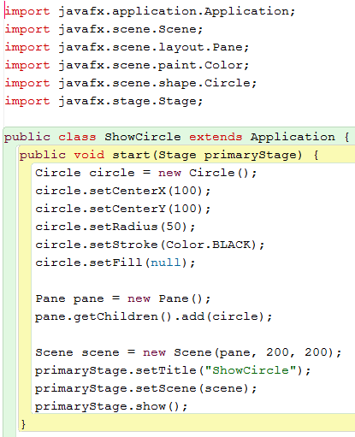
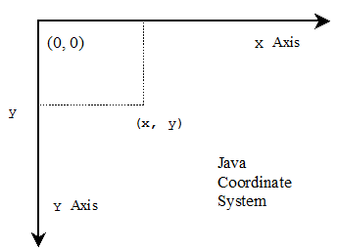
Display a Shape

Slide 11
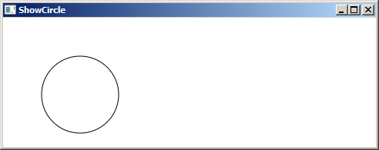
Binding Properties
JavaFX introduces a new concept called binding property that enables a target object to be bound to a source object.
If the value in the source object changes, the target property is also changed automatically.
The target object is simply called a binding object or a binding property.

Slide 12
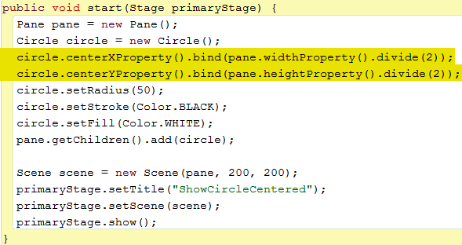
Binding Properties

Slide 13
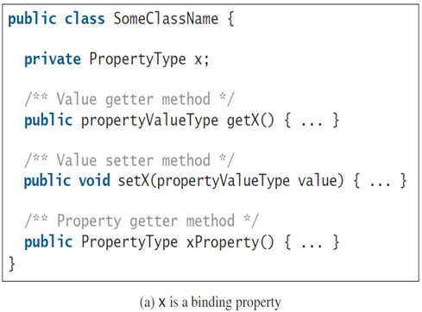
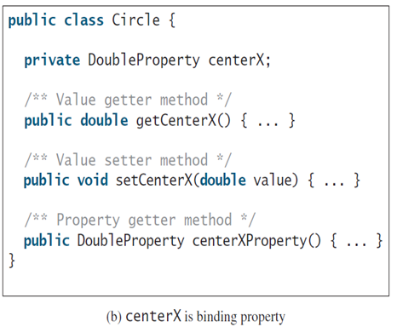
Binding Property: getter, setter, and property getter

Slide 14
Binding Property
JavaFX defines binding properties for primitive types and strings:
Type | Binding Property Type
double | DoubleProperty
float | FloatProperty
long | LongProperty
int | IntegerProperty
boolean | BooleanProperty
String | StringProperty

Slide 15
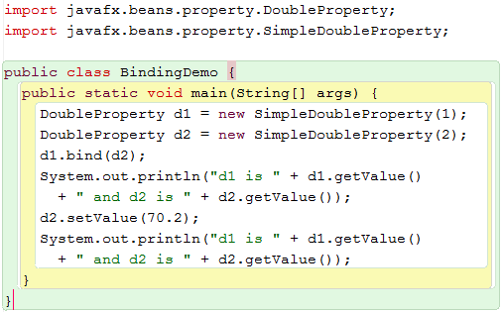
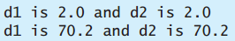

Slide 16
Common Properties and Methods for Nodes
The abstract Node class defines many properties and methods that are common to all nodes.
style: set a JavaFX CSS style
rotate: Rotate a node

Slide 17
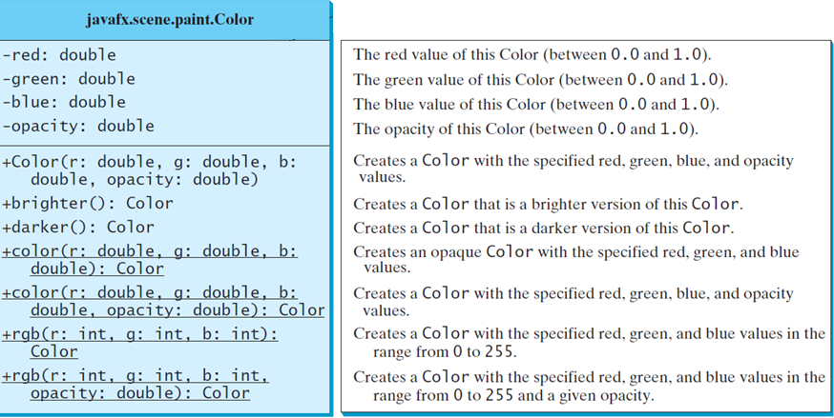
The Color Class

Slide 18
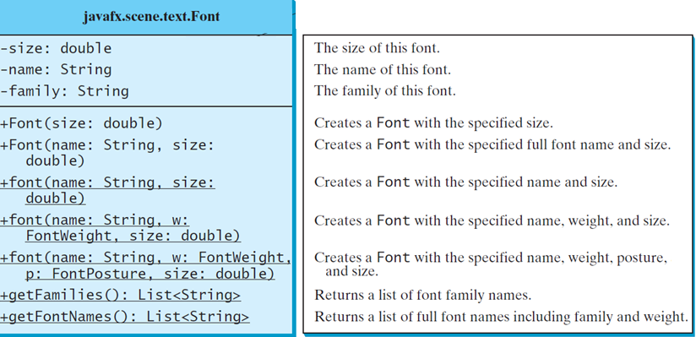
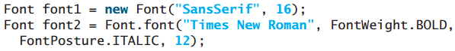
The Font Class

Slide 19
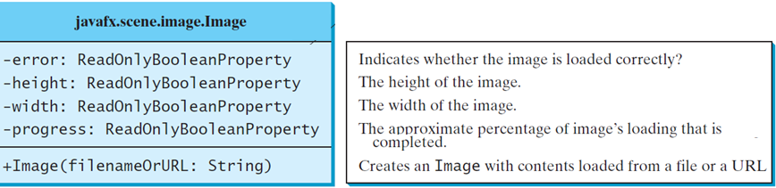
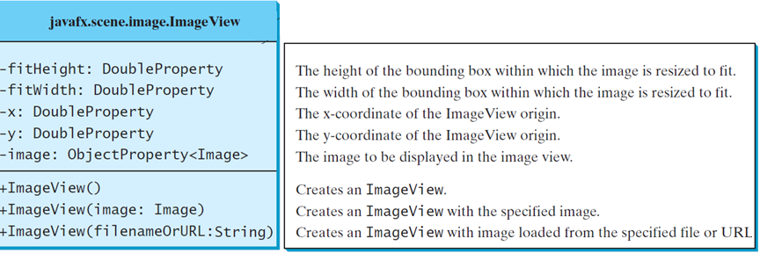
The Image, ImageView Class

Slide 20
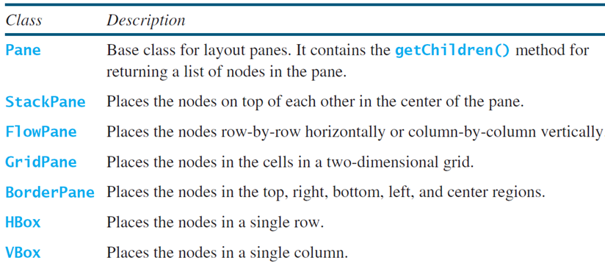
Layout Panes
JavaFX provides many types of panes for organizing nodes in a container.

Slide 21
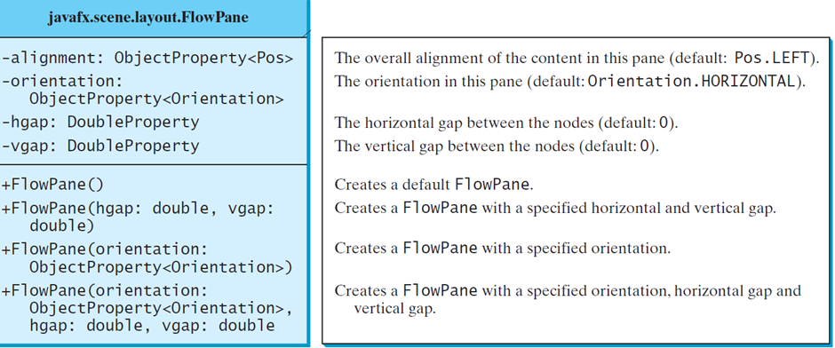
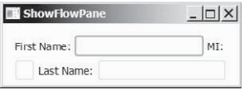
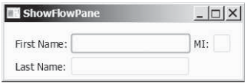
FlowPane

Slide 22
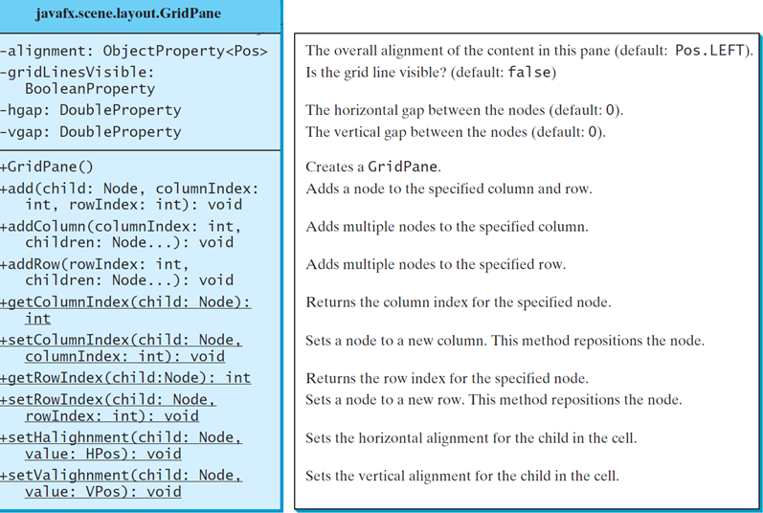
GridPane

Slide 23
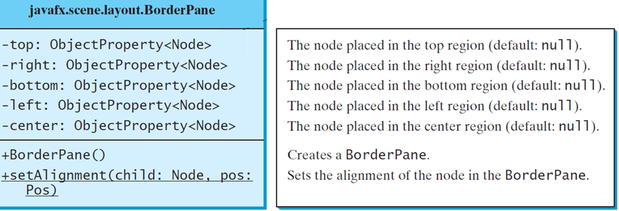
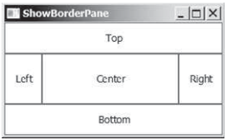
BorderPane

Slide 24
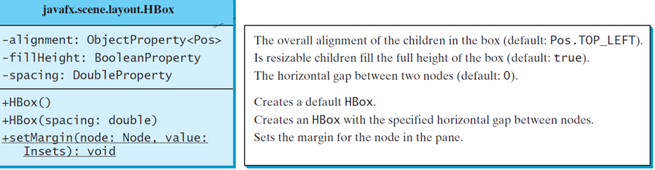
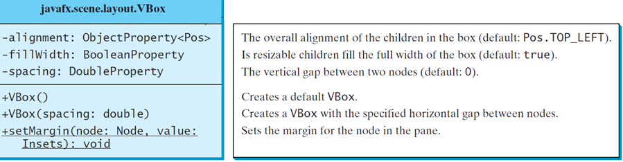
Hbox , VBox

Slide 25
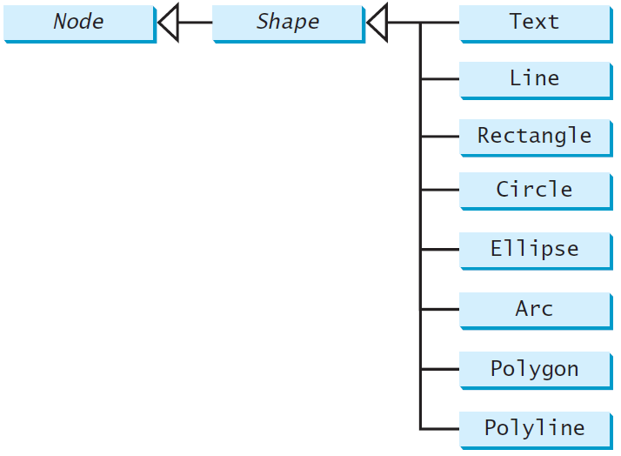
Shapes
JavaFX provides many shape classes for drawing texts, lines, circles, rectangles, ellipses, arcs, polygons, and polylines.

Slide 26
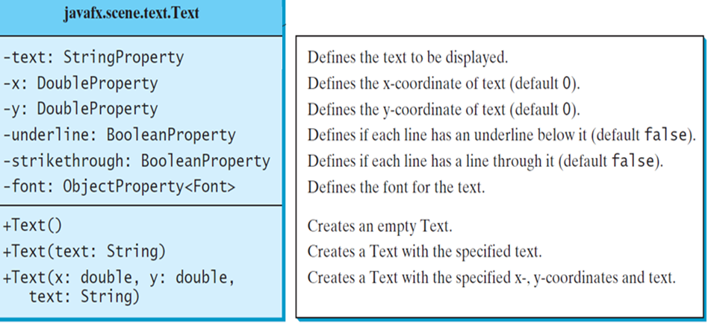
Text

Slide 27
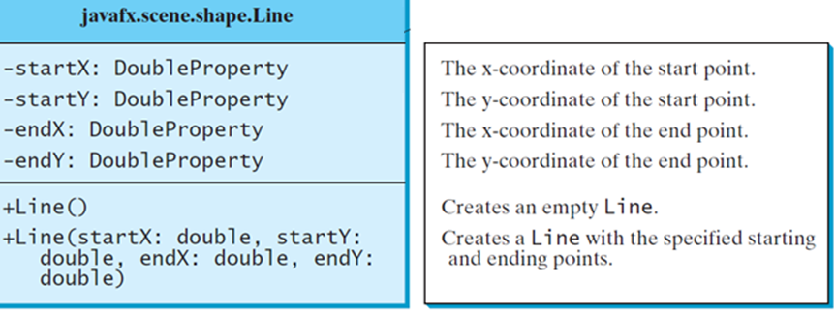
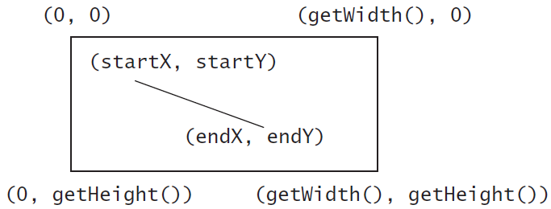
Line

Slide 28
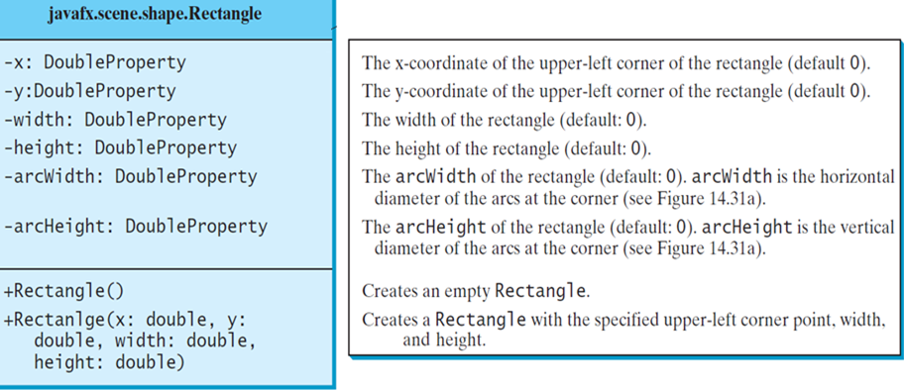
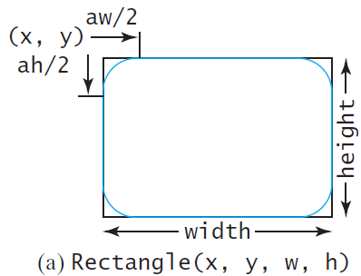
Rectangle

Slide 29
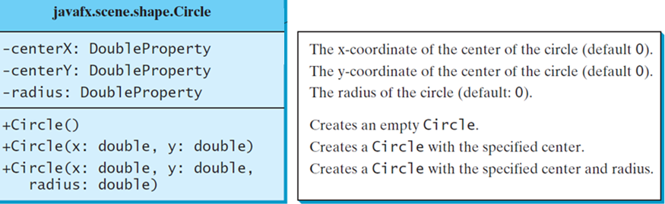
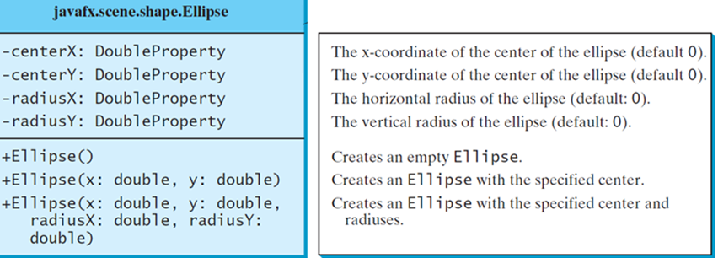
Circle, Ellipse

Slide 30
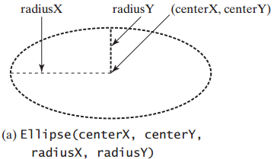
Ellipse

Slide 31
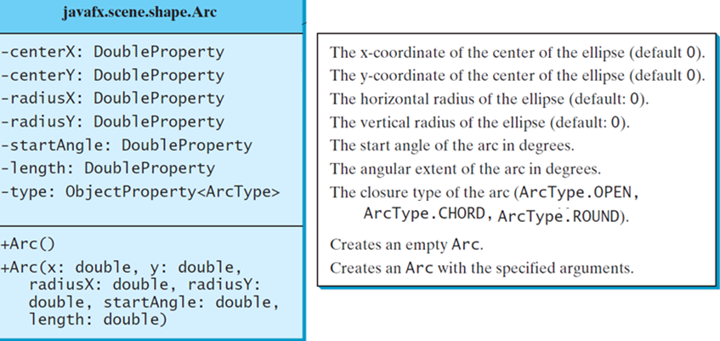
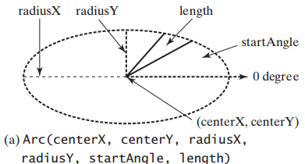
Arc

Slide 32
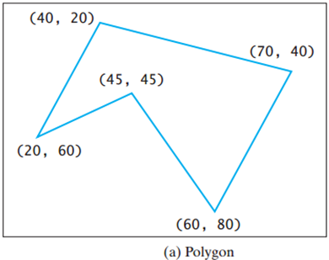
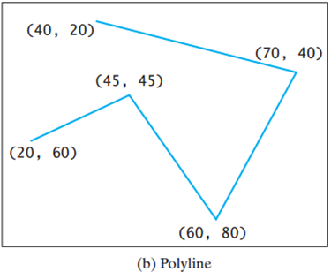
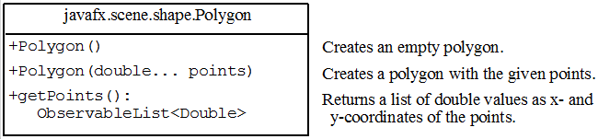
Polygon and Polyline

Slide 33
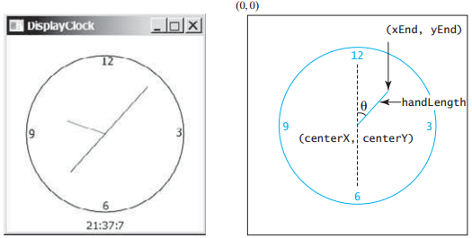
Case Study: The ClockPane Class
This case study develops a class that displays a clock on a pane.

Slide 34
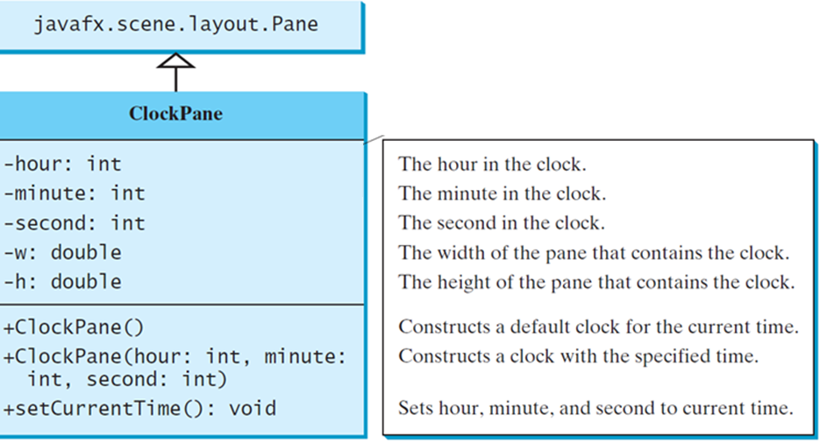
Case Study: The ClockPane Class

